Slide 2
About the Center
Goal: To uphold high quality adolescent sexual and reproductive health programs and services for young people by ensuring professionals and organizations are ready and able to use evidence and innovation.
Research tells us that professionals who receive support—such as training, technical assistance, elearning, networking, etc.—are better able to do their jobs.
And when professionals are better prepared, we see more positive outcomes for young people.

Slide 3
Center Resources
Attending trainings is expensive and time intensive…distance learning, or elearning, offers professional development when YOU want it!
Center resources are…
Available online.
Ready when you want them, on your timing; most courses are self-paced.
Easy to use.
Interactive and engaging…more than just webinars!
And most Center resources are FREE!

Slide 4
How many of you have encountered people who don’t see the value of sex ed in schools?

Slide 5
Practice building effective messages by working through real-world scenarios using evidence-based communication techniques.
For example, work with Karen, your school principle and test scenarios of examples you might bring to Karen, to show why you want to make some changes to your school’s sex ed….and with each you get to see how she’d respond.
You get to test messages and practice, to help you work out how you might use them in real life.
Let’s take a look…

Slide 7
How many of you have had a difficult question you don’t know how to answer?

Slide 8
Explore essential classroom management techniques for the sex education classroom.
You see examples of student behaviors, with examples of teacher responses to redirect or shift the focus back to the lesson.
You also look at some of the characteristics of evidence-based programs, and how they design the classroom setting for success.
There’s also some opportunity for personal reflection.
Let’s take a look…

Slide 9
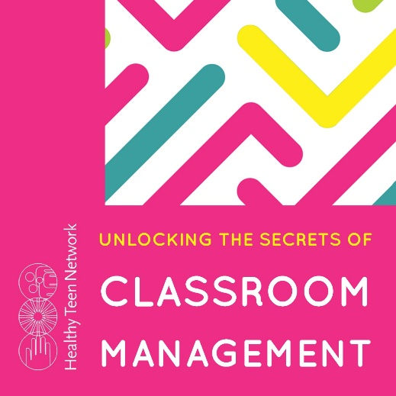

Slide 10
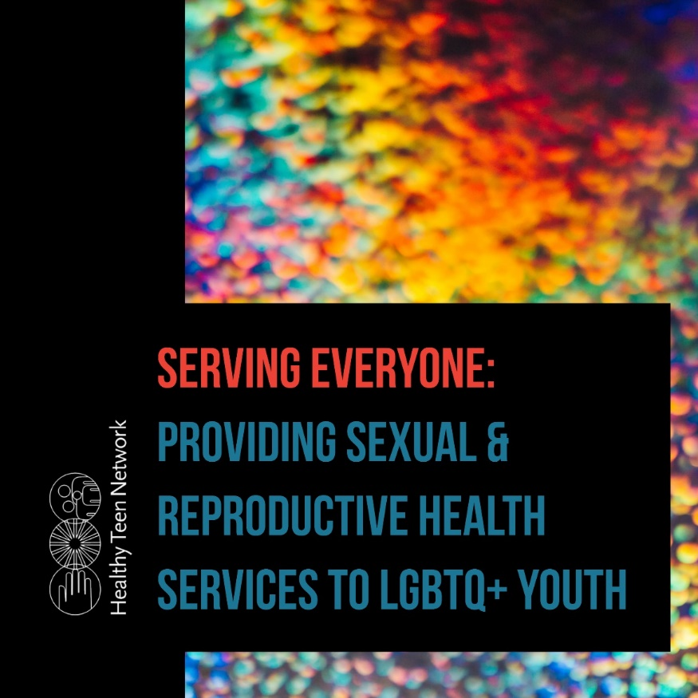
We want to serve all our young people regardless of their gender or sexuality, but sometimes we don’t where to start or what we need to be mindful of.

Slide 11
If you want to keep youth at the center of the services you provide, to empower rather than disarm them, this resource may be of interest to you.
For example, in one scenario, you meet Aliyah: she’s coming to the health center because she’s worried she is pregnant and wants a test. Her new girlfriend, Dani, is aware Aliyah is scared and may be pregnant.
You follow Aliyah along to her visit to the health center, to see what she sees…and get insight to how some of the characteristics of the health center might make her feel included, or not…
Let’s take a look…

Slide 13
How do you navigate the sometimes complicated relationship questions or situations your students deal with every day?

Slide 14
Talking about relationships can be tricky, though of course we know it’s important to teach young people about healthy and unhealthy and abusive relationships.
We all know that providing quality sex ed is more than just anatomy and pregnancy. But how do you focus on all the stuff that matters to help students make informed and healthy choices?
For example, in one lesson, you get sample questions, then you view videos with sample responses, and you choose the one that best responds to the question. You then get feedback on your choice.
Let’s take a look…

Slide 16
The Teacher’s Guide is EIGHT Resources in ONE!
Puberty & the Reproductive System
Preventing Pregnancy & Infection
HIV & STIs
Techniques & Approaches for a Healthy Sex Ed Class
Laws & Policies Related to Teaching Sex Ed
Answering Sensitive Questions & Maintaining Boundaries
Sexuality & Gender 101
The Basics of Teaching Students about Healthy Relationships

Slide 17
And More…Now & Even More Coming Soon…

Slide 18
Please complete the feedback form for each resource, so we can continue to improve them!
www.healthyteennetwork.org/center/elearning/

